Slide 1

Slide 1
DATA DRIVEN
Annual Sales Insights Report

Slide 2
Slide 2
INTRODUCTION
This Power BI Sales Dashboard was developed using raw data from Excel files containing information on sales transactions, customers, products, and delivery regions.The objective of the project is to convert raw data into interactive visual insights that help identify. The objective of the project is to convert raw data into interactive visual insights that help identify:
Total revenue, quantity sold, and profit.
Top-performing customers and products.
Revenue distribution across cities and channels.
Sales trends over time.
This dashboard provides a single view of the business's performance in 2018, supporting strategic decisions through data-driven insights.
2

Slide 3
Slide 3
DATA SOURCSE
This project is built using four Excel tables:
Sales Orders Table :
This table holds all transaction-level sales data. It includes details such as sales channels, currency,
warehouse code, delivery region and product indexes, order quantity, unit price, total cost, and total revenue.
It serves as the central fact table in the model, linking to dimension tables using foreign keys.
Customers Table :
This table contains customer information with unique customer indexes and corresponding customer names.
It acts as a dimension table to provide detailed customer data, which is linked to the sales transactions for
analysis of customer-specific sales patterns..
Products_Table :
This table lists product indexes alongside their corresponding product names. It serves as a simple
reference to identify products by their unique index numbers.
Regions_Table :
This table provides detailed geographical information including suburb, city, postcode, longitude, latitude,
and full address. It serves as a reference for delivery regions to analyze sales by specific locations and supports
spatial analysis in the dataset..
3

Slide 4
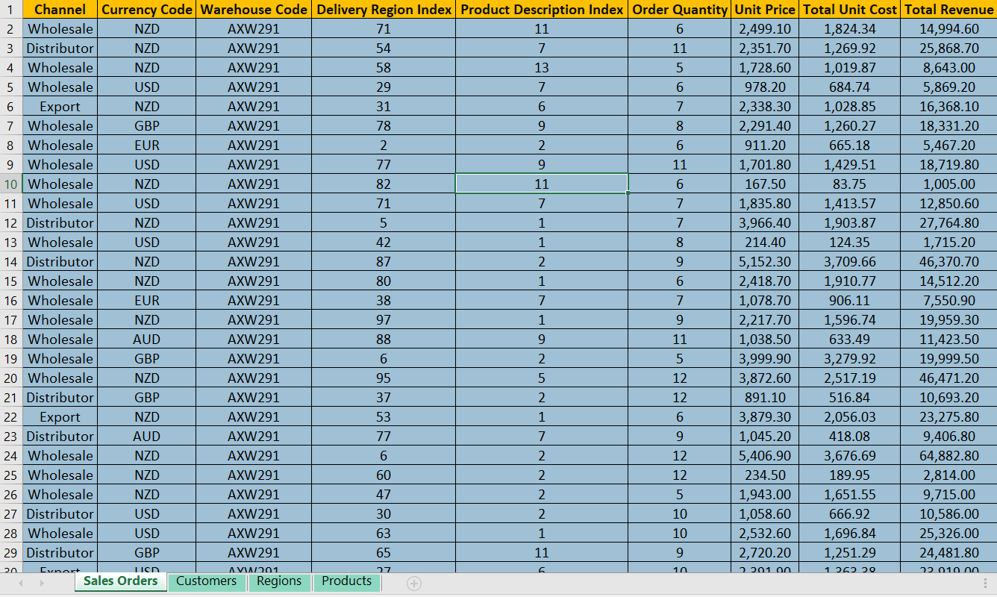
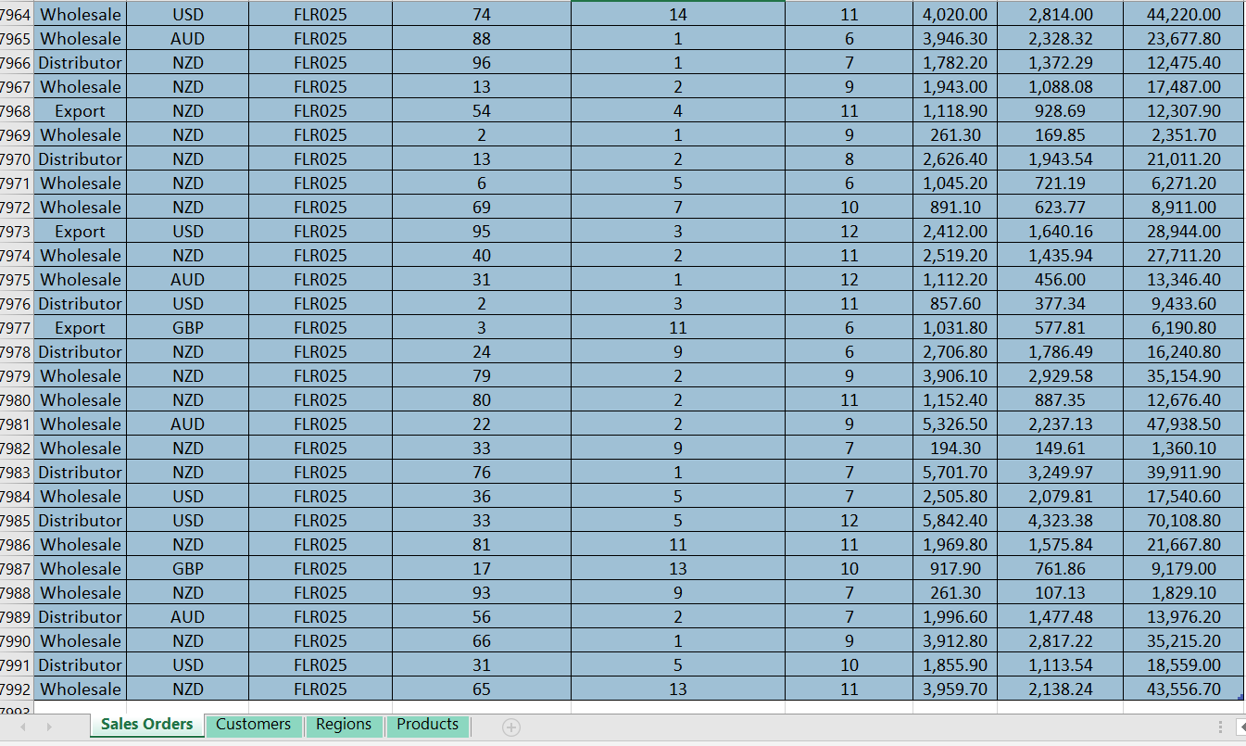
Slide 3
SALES ORDERS TABLE
The Sales Orders table contains detailed records of sales transactions. Each row represents an individual sales order with information on "Channel" (Str), "Currency Code" (Str), "Warehouse Code" (Str), "Delivery Region Index" (Int), "Product Description Index" (Int), "Order Quantity" (Int), "Unit Price" (Dec), "Total Unit Cost" (Dec), and "Total Revenue" (Dec). This table helps track and analyze sales performance and financial metrics across different regions and products. It includes 7992 data rows.
3

Slide 5
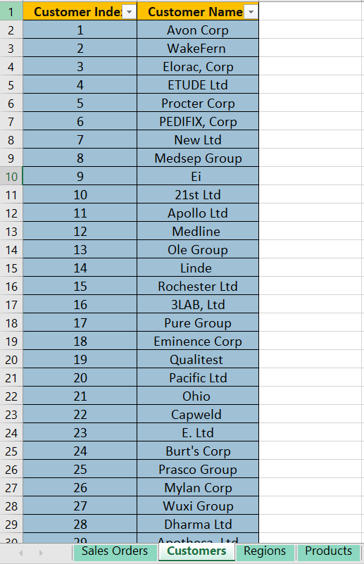
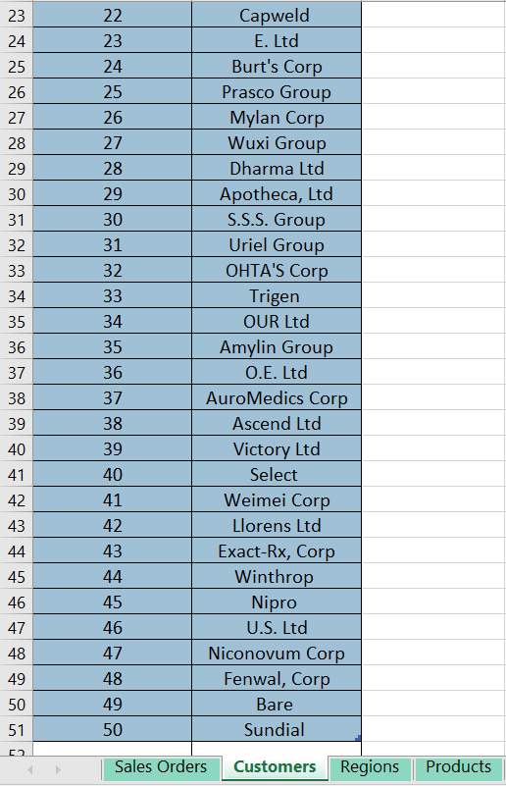
Slide 3
CUSTOMERS TABLE
This table contains customer information with unique customer indexes and corresponding customer names. It helps identify and analyze customer-specific sales data. The Customers table contains 51 data rows plus a header row. The columns are Customer Index (Int), Customer Name (Str).
3

Slide 6
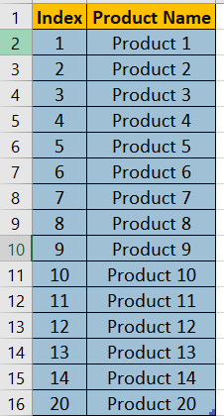
Slide 3
PRODUCTS TABLE
This table lists products with unique product indexes and product names. It serves as a reference to map sales transactions to specific products. The Products table contains 16 data rows plus a header row. The columns are Product Index (Int), Product Name (Str).
3

Slide 7
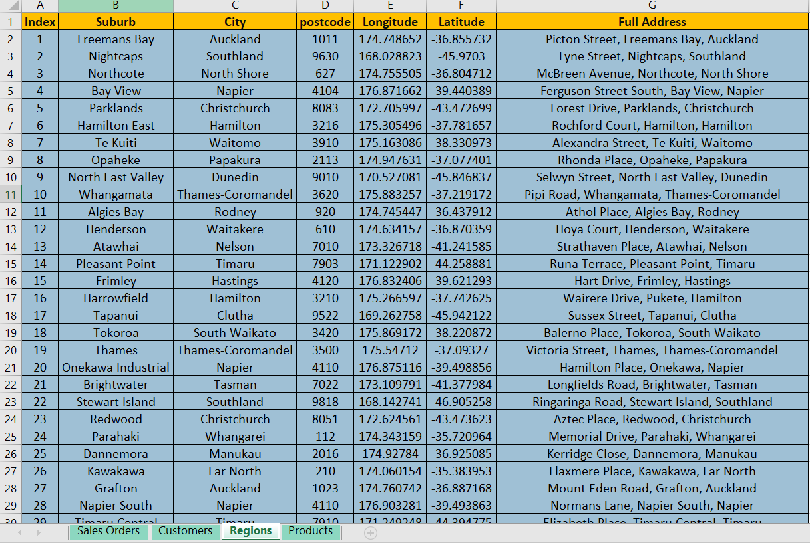
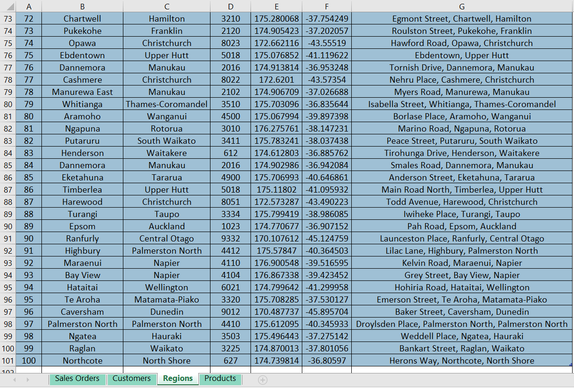
Slide 3
REGIONS TABLE
This table holds geographical information related to delivery locations, including suburb, city, postcode, longitude, latitude, and full address. It supports location-based sales analysis and mapping. The Regions table contains 100 data rows plus a header row. The columns are Index (Int), Suburb (Str), City (Str), Postcode (Str), Longitude (Dec), Latitude (Dec), Full Address (Str).
3

Slide 8
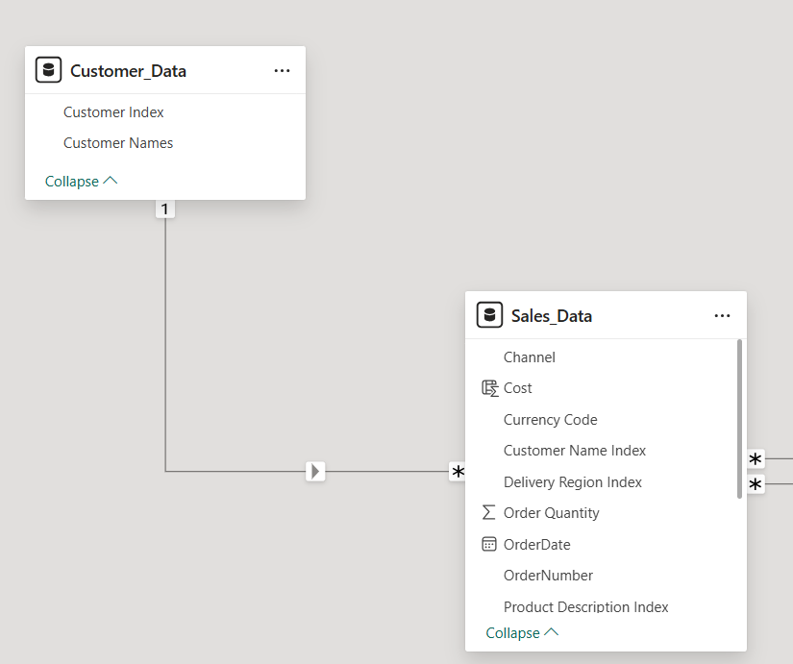
Slide 3
DATA MODEL RELATIONSHIP
One-to-many relationship between the Customer_Data table and the Sales_Data table.
The Customer_Data table contains unique customer details, with Customer Index acting as the primary key.
The Sales_Data table records sales transactions, including details like Channel, Cost, Currency Code, Order
Quantity, and OrderDate.
The link is made through the Customer Index in Customer_Data connecting to the Customer Name
Index in Sales_Data.
This means each customer can have multiple sales records, but each sale is associated with only one
customer, enabling efficient tracking and analysis of sales by customer.
3

Slide 9
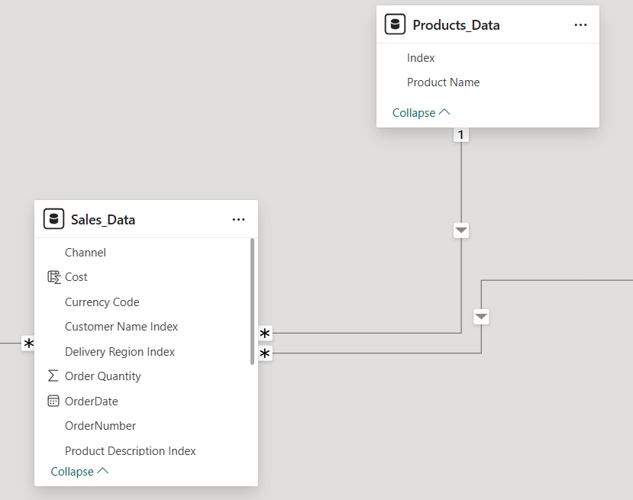
Slide 3
DATA MODEL RELATIONSHIP
One-to-many relationship between the Products_Data table and the Sales_Data table.
The Products_Data table contains unique product details, with Index as the primary key.
The Sales_Data table records individual sales transactions including Order Quantity, Order Date, Profit, and Ship Date.
The connection is made via the Product Description Index in Sales_Data, which links to the Index in Products_Data.
This relationship means that each product in the Products_Data table can appear in many sales records in the Sales_Data table, allowing detailed tracking of sales per product.
3

Slide 10
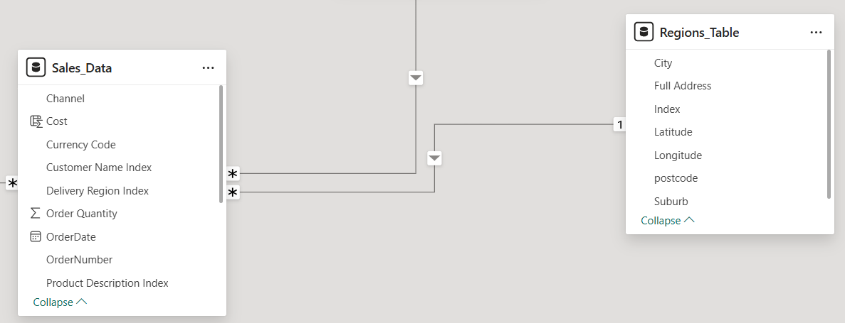
Slide 3
DATA MODEL RELATIONSHIP
One-to-many relationship between the Regions_Table and the Sales_Data table.
The Regions_Table contains unique region details with Index as the primary key.
The Sales_Data table contains sales transactions including details like Order Quantity, Order Date, Profit, and Ship Date.
The connection is made via the Delivery Region Index in Sales_Data, which links to the Index in Regions_Table.
This means each region in the Regions_Table can have multiple related sales records in Sales_Data, enabling analysis of sales by region.
3

Slide 11
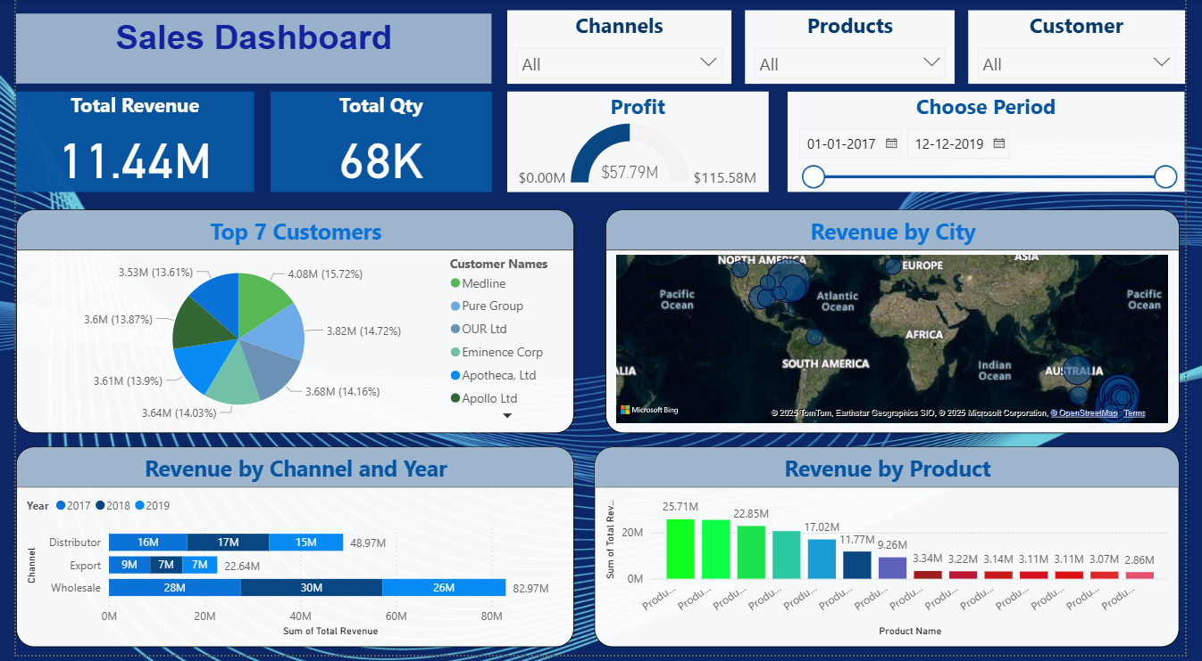
Slide 3
SALES AND PRODUCT INSIGHTS DASHBOARD
This dashboard presents an overview of sales performance from 01-01-2017 to 12-12-2019, highlighting key metrics such as Total Revenue (11.44M), Total Quantity Sold (68K), and Profit ($57.79M). It includes insights into top-performing customers, channels, products, and regions. Visuals such as the top 7 customers pie chart, revenue by city map, product-wise revenue bars, and year-wise channel performance help analyze trends and identify growth opportunities across segments. Filters for Channel, Product, and Customer allow dynamic exploration.
3

Slide 12
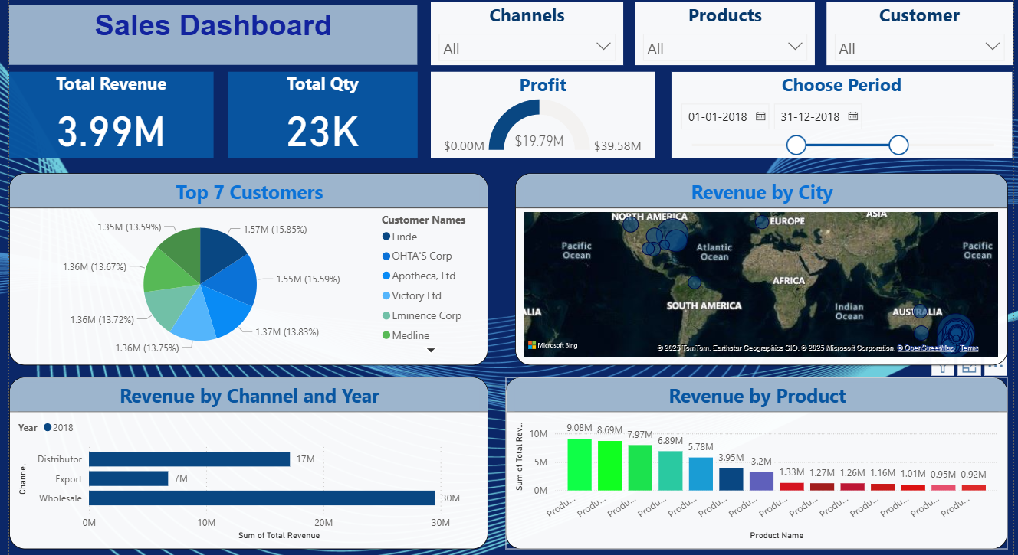
Slide 3
SALES PERFORMANCE DASHBOARD – YEAR 2018
This dashboard presents detailed sales insights for the year 2018. It highlights total revenue, total quantity sold, and profit generated during this period. Users can explore sales distribution across different channels, top-performing customers, product-wise revenue, and city-wise sales concentration, offering a comprehensive view of business performance throughout 2018.
3

Slide 13
Slide 2
CONCLUSION
The sales data from 2017 to 2019 reveals consistent performance with total revenue reaching 11.44M
and a total quantity of 68K units sold.
The highest profits were driven by a few key customers and top-performing products.
Wholesale remained the most significant sales channel, while certain cities and regions generated
higher revenues.
These insights can help focus future sales strategies on high-performing segments and optimize
resource allocation for continued growth.
2

Slide 14

Slide 11
THANK YOU

